Slide 1
An Abstract Model of the Cultural Evolution of In-Groups
Bruce Edmonds Centre for Policy Modelling Manchester Metropolitan University

Slide 2


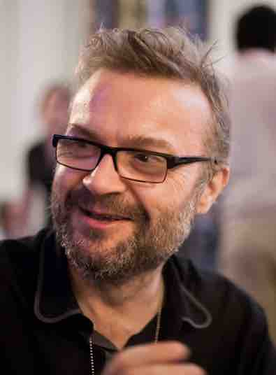
Acknowledgements
Work was initially funded by EPSRC, as part of the “Social Complexity of Immigration and Diversity” project, (grant number EP/H02171X) to start modelling ethnocentrism (Edmonds et al. 2020)
The majority of the work was done by my friend, David Hales, especially in the development and exploration of the simpler model, published in (Hales & Edmonds 2018)

Slide 3
Basic Ideas Behind these Models
We assume agents distinguish between in-groups and others, but not:
how they define their in-groups
how this affects their behaviour
All agents have observable characteristics (‘tags’) that others can use to determine whether they are in their in-group
Two kinds of tag, those that:
can be changed easily: ‘cultural’ (clothes etc.)
those that can not: ‘ethnic’ (skin colour, sex etc.)
Groupings of agents evolve through interaction and imitation (but no change of ethnic tags)

Slide 4
General approach
Using quite abstract models (which Dave likes :-/)…
…apart from key assumptions, bung in all possibilities at the start and let the system evolve (with particular parameters)…
…in order to see what possible kinds of outcome these mechanisms can have
This can inform the formation of hypotheses or counter-examples to assumptions (e.g. that ethnocentrism evolves genetically as in Hammond & Axelrod 2006)

Slide 5
How agents define their in-group
All agents are given an arbitrary way of defining in-group at start, including:
others with similar cultural tags to themselves
others with similar ethnic tags to themselves
others with similar cultural and ethnic tags
Periodically, agents compare themselves with another and if that agent is doing better than them, they imitate that agent in all aspects except ethnic tags (i.e. the mutable aspects)
Sometimes agent might change a mutable aspect randomly (mutation)

Slide 6
Action during interaction
There is no fixed connection between tags and behaviour
Agents have a pair of strategies that determines their behaviour during interaction: one for their in-group, one for others
Possible actions (all in terms of a score),
Do nothing, ‘Sit’ (S)
Give value to the other (D) (at small cost to self)
All possibilities there at start (e.g. ignore in-group, donate to others, donate to in-group and others etc.)

Slide 7
Simpler Version of model
The ‘ECT’ model used in (Hales & Edmonds 2018)
Two integers: one for ethnic tag, one for cultural tag
Four possible in-group definitions:
SN = in-group is everybody
SC = cultural in-group (same cultural tag)
SE = ethnic in-group (same ethnic tag)
SB = both in-group (same both tags)
Four strategy combinations:
DS = donate to in-group only
SS = donate to nobody
DD = donate to everybody
SD = donate to out-group only

Slide 8
Model Processes
Each tick all agents do the following as follows:
Partner Selection: select another in its in-group as self (if there is one) otherwise another at random
Game Interaction: donate to this other or not depending on strategies and whether other is in- or out-group
Imitation: select another from anywhere, if other’s payoff > its own, copy the other’s: selector, cultural tag and strategies (but not its ethnic tag)
Innovation: with small probabilities change (a) cultural tag to a random other and (b) change one of its strategies or selector

Slide 9
Summary of results
High levels of donation evolve in many (but not all) parameter settings
Highest when interaction is in-group whilst imitation is global (can imitate anyone)
Culturally defined in-groups dominate (sometimes oscillating with purely selfish)
Sometimes culturally+ethnically defined groups appear
Levels of donation to different cultural tags very small – no pure ethnocentrism

Slide 10
Dominating Model Process
On inspection of many runs the following two processes seem to dominate the dynamics:
By chance a new “seed group” of two mutual cooperators appears, these have a high mutual donation and hencea high score and so are imitated by others; the group grows quickly producing a surge of whatever kind of selector was in the seed individuals
After a while the group is “infected” by defecting individuals who receive but do not donate (by innovation), the payoff of agents in the group gradually diminishes and eventually individuals copy a new group

Slide 11
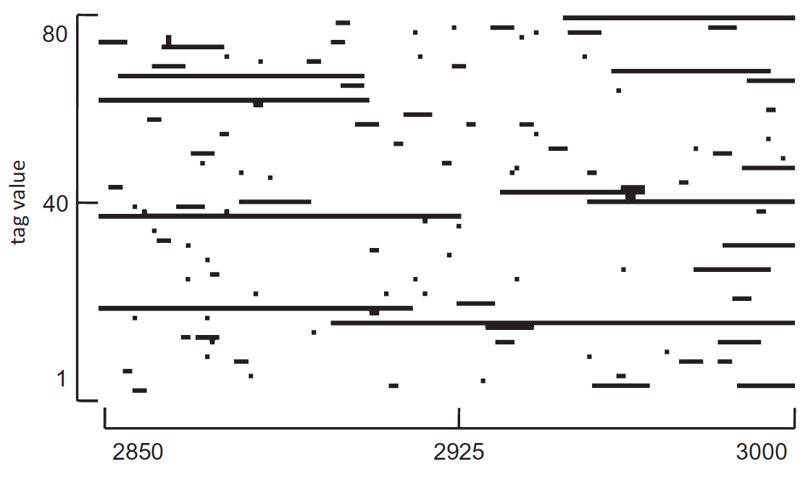
Cultural groups forming and dying

Slide 12
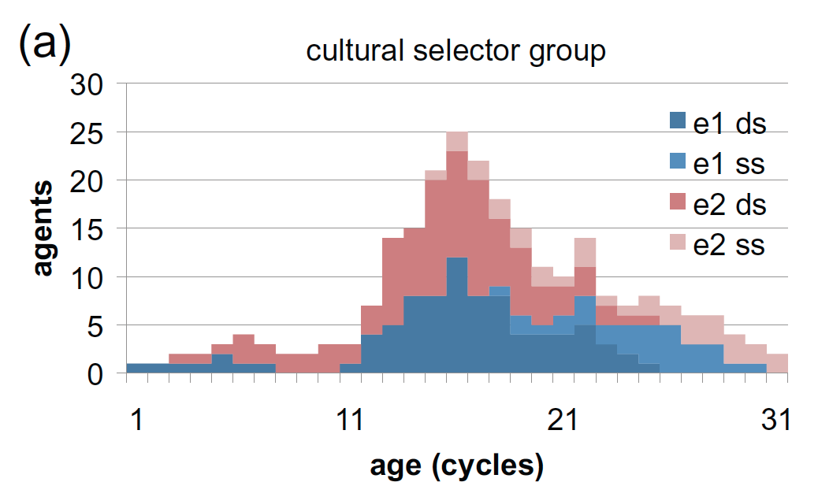
Cross section of ethnic&culturally defined group over time

Slide 13
More complex version of model
Ethnic and cultural tag are each real numbers
Each agent also has two “tolerances” for deviation from their values in ethnic and in cultural value to define in-group (next slide)
New action – ‘fight’ (F) which subtracts a score from the other (at a small cost to self)
Can have different locations
Can have also genetic evolution (so compare mix of genetic and cultural)
Lots of options to check assumptions
New visualisations ☺

Slide 14
Illustration of characteristics, tolerances and in-group
Ethnic tolerance
Cultural tolerance
Range of cultural characteristics
Range of ethnic characteristics

Slide 15
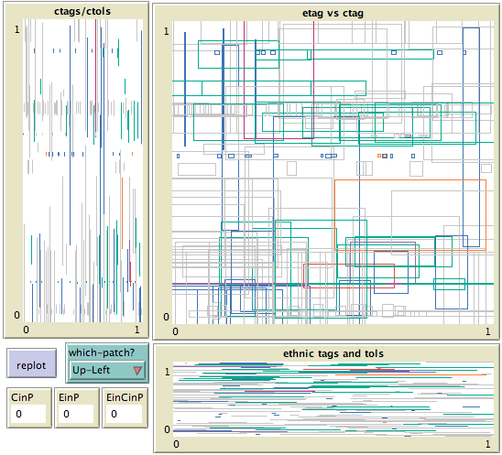

A visualisation of a population
Each rectangle represents an individual
Projections to 1D
FS
Cultural Picture only
Ethnic picture only
“Fight” in-group
“Sit” with out-group

Slide 16
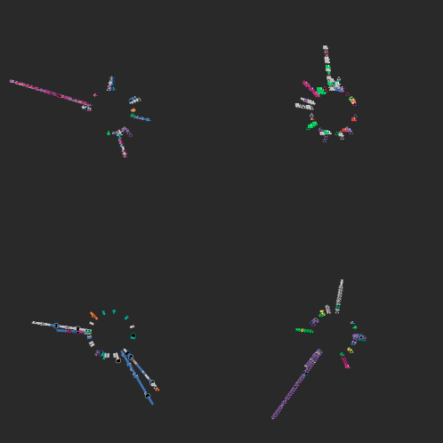
Each ‘spoke’ is a group of culturally identical agents
Colours indicate behaviour, shape is ethnicity
A Patch

Slide 17
Characteristics of this model
In-groups or identity might partially emerge from social rather than cognitive processes
Donation to similar cultural tags which are more closely defined still dominate
But there is a more complex mix of strategies
Mixtures of spatial, in-group and genetic evolution can be explored
Agents have no memory, just current tolerances, strategies and tags
No meaningful communication in model
Interaction is very basic via a single score

Slide 18
How this relates to the SIA
Groups and their functionality emerge rather than are hard-coded, but “in-groupness” based on similarity is assumed
Emphasis on changing identity rather than adapting perceptions and stereotypes
Other versions allow multi-dimensional characteristics, so which are relevant for characterising which groups emerges
Allows room for imposing various biases in terms of perceptions of groups/identities
No alternative social identities depending on context/relationships etc.

Slide 19
Some References
Edmonds, B., Hales, D. and Lessard-Phillips, L. (August 2020) Simulation Models of Ethnocentrism and Diversity: An Introduction to the Special Issue. Social Science Computer Review, Published online DOI:10.1177/0894439318824316
Hales, D. & Edmonds, B. (2019) Intragenerational Cultural Evolution and Ethnocentrism. Journal of Conflict Resolution, 63(5):1283-1309. https://doi.org/10.1177/0022002718780481.
Hales, David, & Edmonds, Bruce (2015, October 16). "EthnoCultural Tag model (ECT)" (Version 1). CoMSES Computational Model Library. Retrieved from: https://www.comses.net/codebases/4744/releases/1.0.0/
Hammond, R. & Axelrod, R. (2006). The Evolution of Ethnocentrism. Journal of Conflict Resolution, December 2006, 50: 926-936, doi:10.1177/0022002706293470

Slide 20
Thanks!
Bruce Edmonds: bruce@edmonds.name
Centre for Policy Modelling: http://cfpm.org
Slides at: http://cfpm.org/slides and in Slack
Models at: http://cfpm.org/models and in Slack

